Slide 1
ShanghaiTech University
EE 115B: Digital Circuits
Fall 2024
Lecture 8
Hengzhao Yang
October 29, 2024

Slide 2
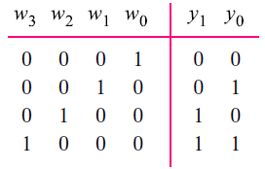
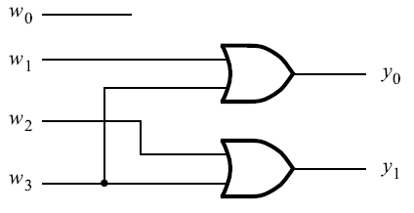
Encoders
4-to-2 binary encoder
Prof. Yajun Ha

Slide 3
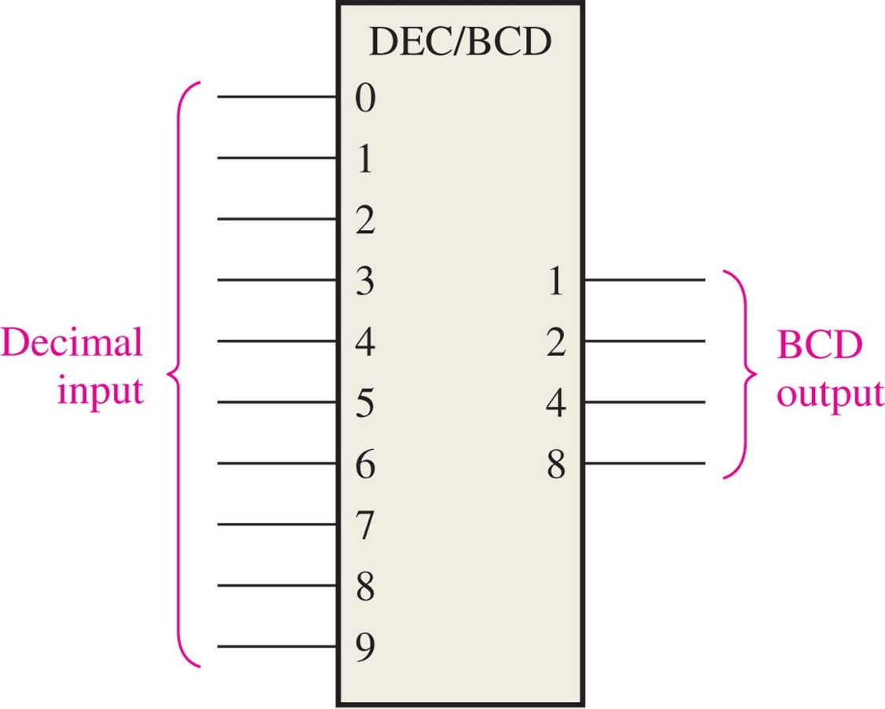
FIGURE 6-36 Logic symbol for a decimal-to-BCD encoder.
Decimal-to-BCD encoder (10-line-to-4-line)
_____________________________________________

Slide 4
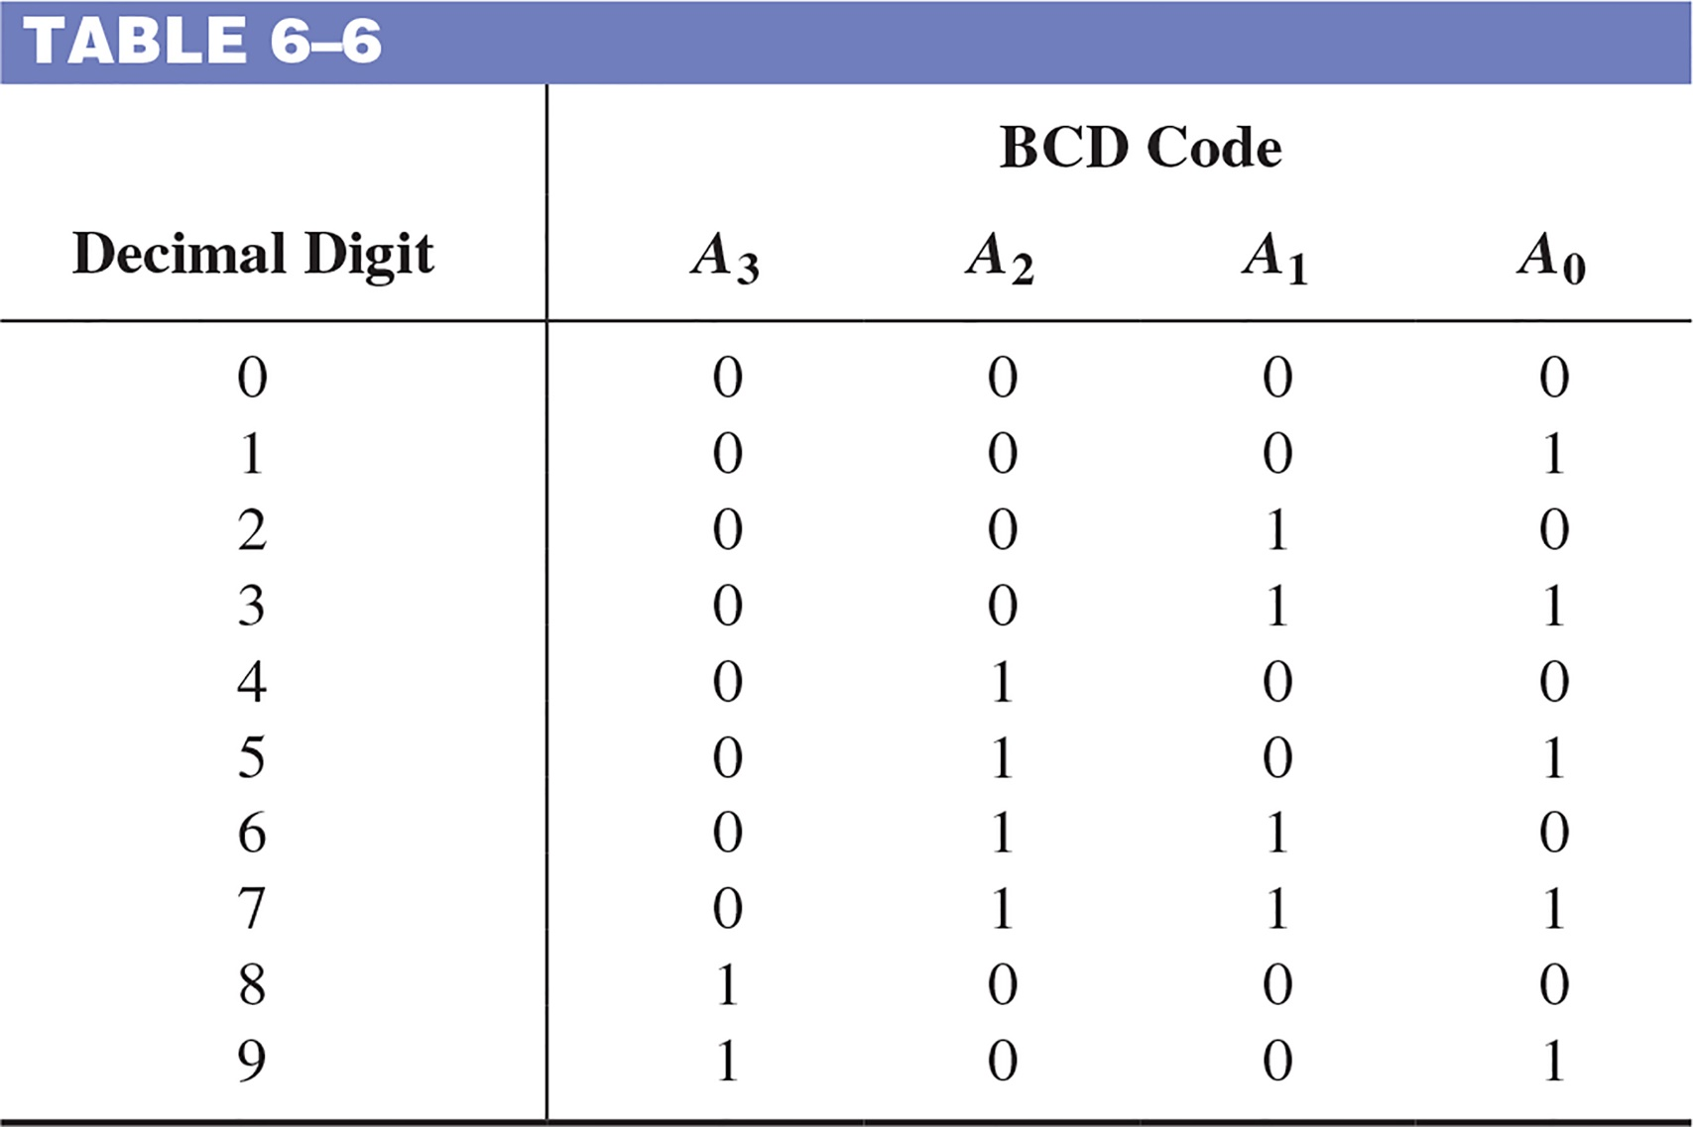
Decimal-to-BCD encoder (10-line-to-4-line)
_____________________________________________

Slide 5
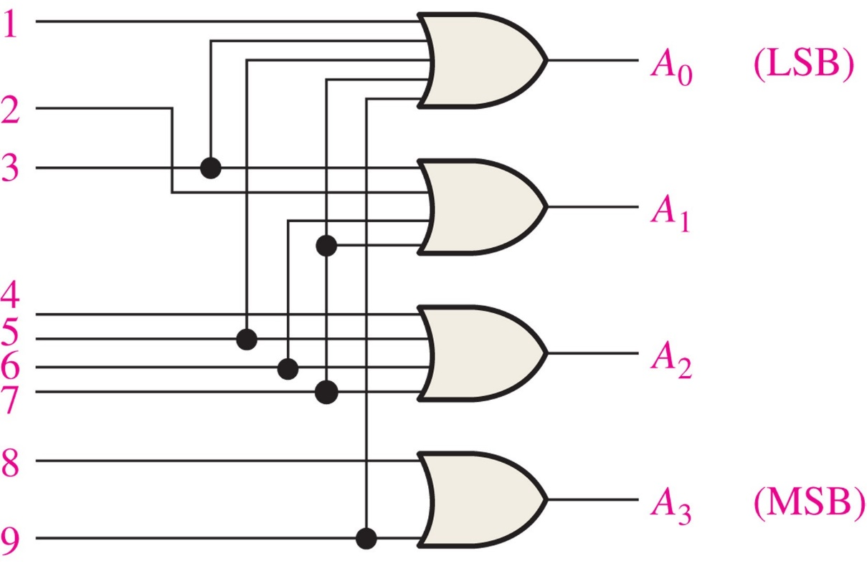
FIGURE 6-37 Basic logic diagram of a decimal-to-BCD encoder. A 0-digit input is not needed because the BCD outputs are all LOW when there are no HIGH inputs.
Decimal-to-BCD encoder (10-line-to-4-line)
_____________________________________________
A₃=8+9
A₂=4+5+6+7
A₁=2+3+6+7
A₀=1+3+5+7+9

Slide 6
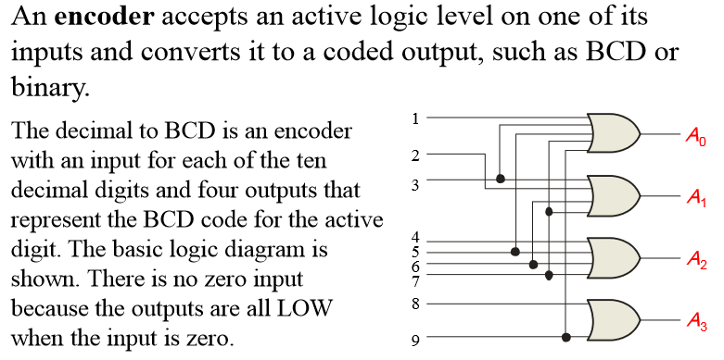
Decimal-to-BCD Encoder
Notes:
Title

Slide 7
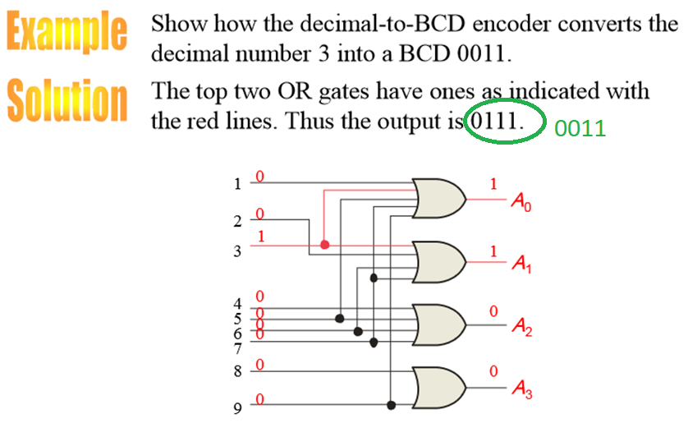
Decimal-to-BCD Encoder
Notes:
Title

Slide 8
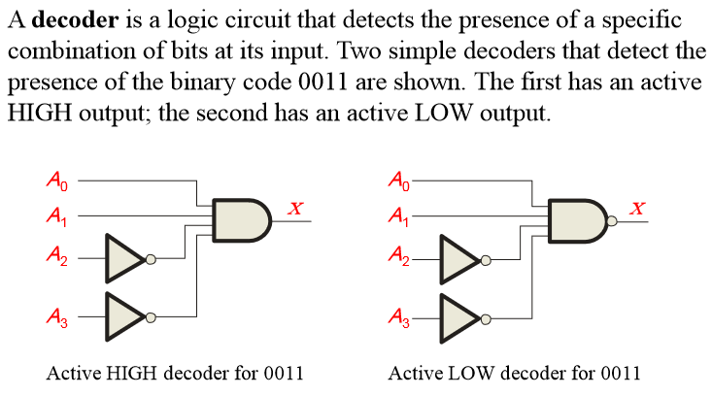
Decoders
Notes:
Title

Slide 9
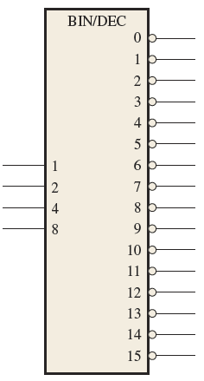
Decoders
Input: from a particular combination to any combination
Output: from one to multiple
A 4-line-to-16-line (also called 1-of-16) decoder: active LOW
Prof. Yajun Ha

Slide 10
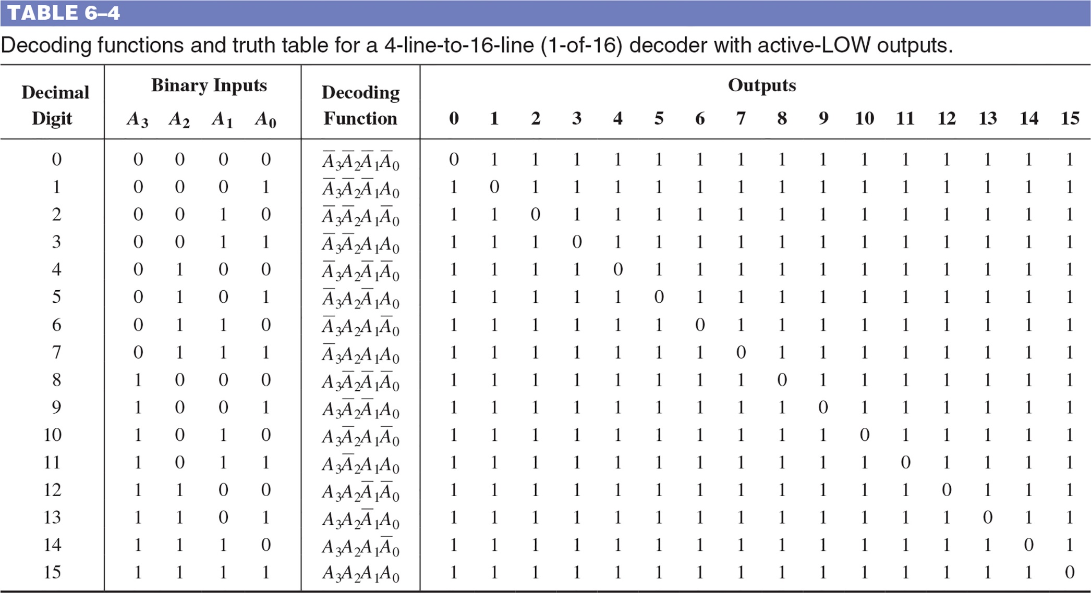
TABLE 6–4 Decoding functions and truth table for a 4-line-to-16 line (1-of-16) decoder with active-LOW outputs.

Slide 11
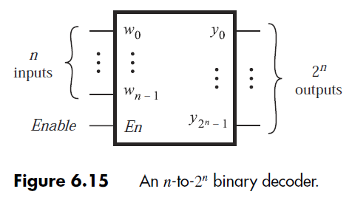
Binary Decoders
Decoders: decode encoded information.
Binary decoders: decode information from n-bit binary inputs to 2^{n} outputs.
Exactly one output is asserted: one-hot code.
Prof. Yajun Ha

Slide 12
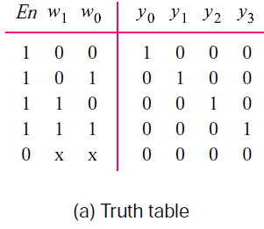
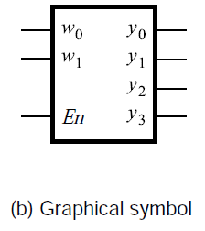
Binary Decoders
2-to-4 decoder with ENABLE input.
En=0: none of outputs is asserted (i.e., y₃=y₂=y₁=y₀=0)
En=1: binary input w₁w₀ determines which output is asserted
Prof. Yajun Ha

Slide 13
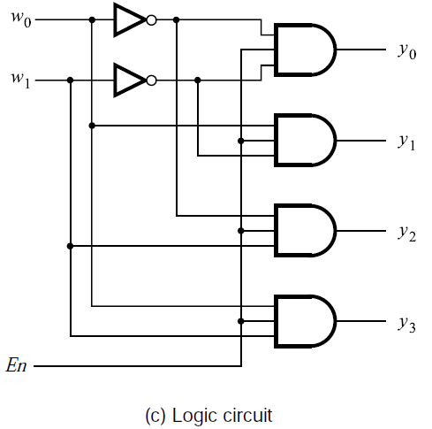
Binary Decoders
2-to-4 decoder with ENABLE input.
Prof. Yajun Ha

Slide 14
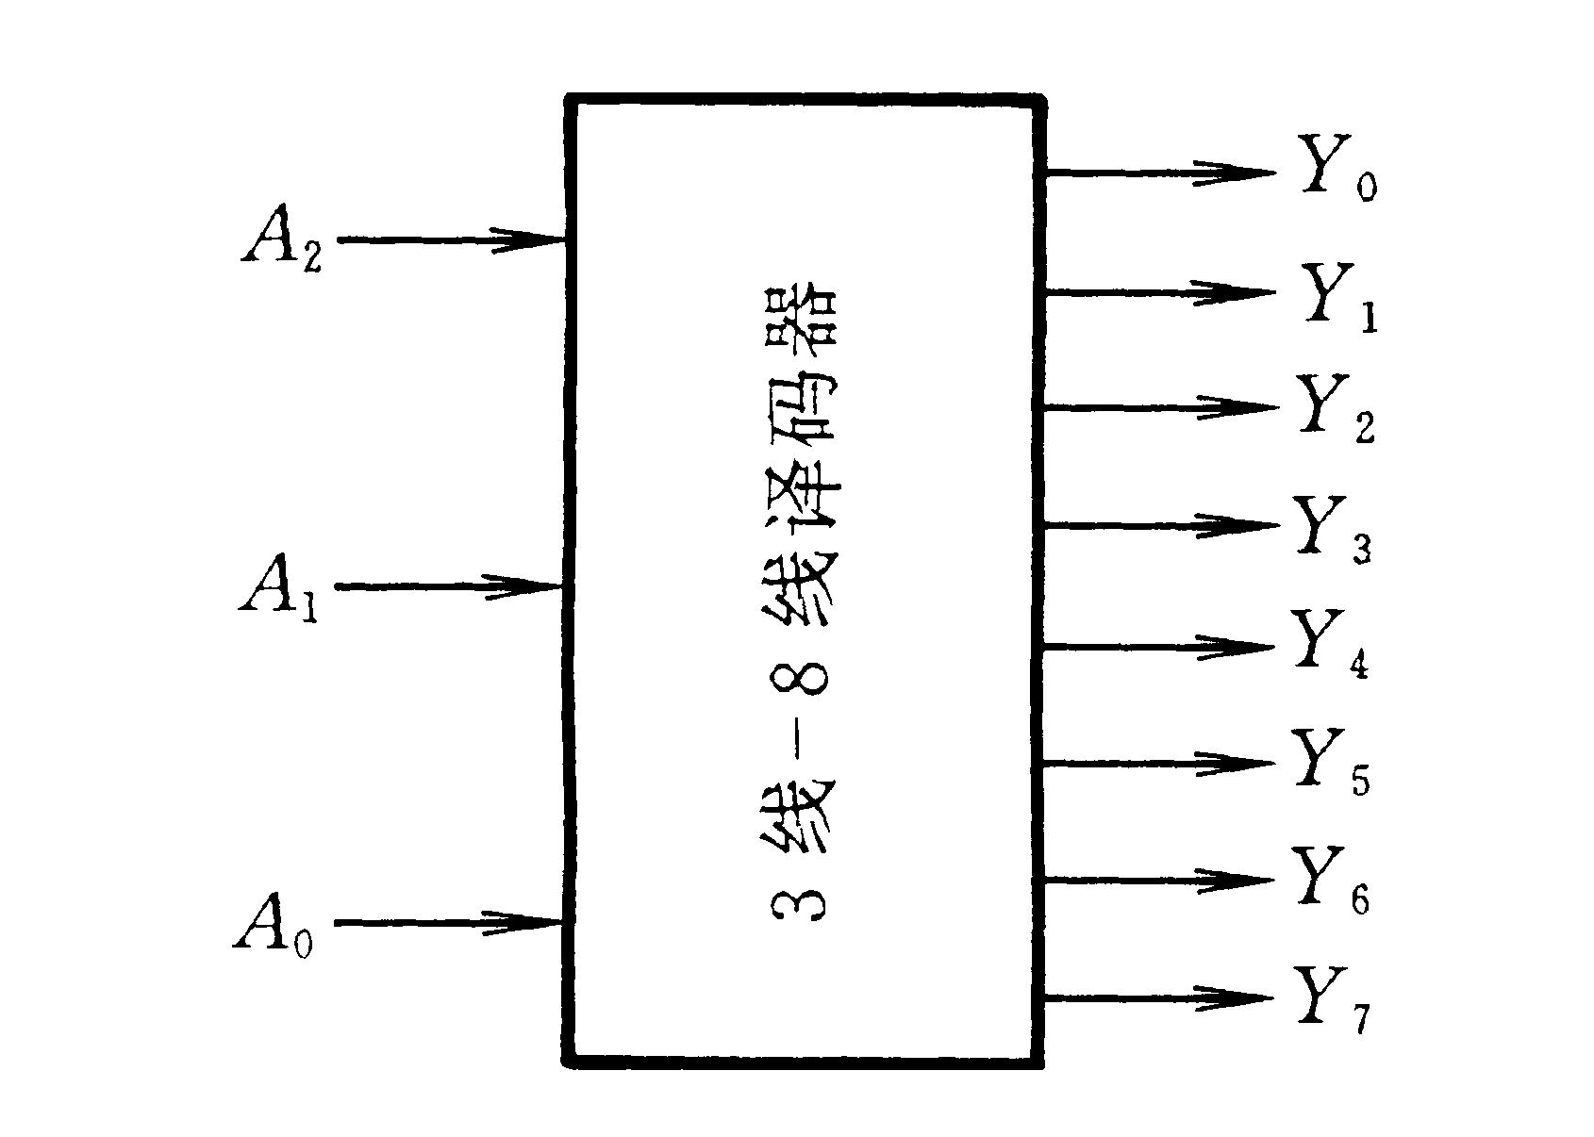
4.4.2 译码器
译码：将每个输入的二进制代码译成对应的输出高、低电平信号。
输 入 |  |  | 输 出
A₂ | A₁ | A₀ | Y₇ | Y₆ | Y₅ | Y₄ | Y₃ | Y₂ | Y₁ | Y₀
0 | 0 | 0 | 0 | 0 | 0 | 0 | 0 | 0 | 0 | 1
0 | 0 | 1 | 0 | 0 | 0 | 0 | 0 | 0 | 1 | 0
0 | 1 | 0 | 0 | 0 | 0 | 0 | 0 | 1 | 0 | 0
0 | 1 | 1 | 0 | 0 | 0 | 0 | 1 | 0 | 0 | 0
1 | 0 | 0 | 0 | 0 | 0 | 1 | 0 | 0 | 0 | 0
1 | 0 | 1 | 0 | 0 | 1 | 0 | 0 | 0 | 0 | 0
1 | 1 | 0 | 0 | 1 | 0 | 0 | 0 | 0 | 0 | 0
1 | 1 | 1 | 1 | 0 | 0 | 0 | 0 | 0 | 0 | 0
一、二进制译码器
例：3线—8线译码器

Slide 15
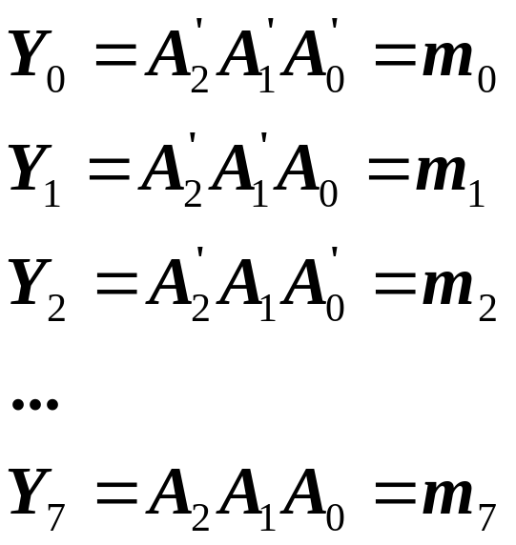
逻辑表达式：
输 入 |  |  | 输 出
A₂ | A₁ | A₀ | Y₇ | Y₆ | Y₅ | Y₄ | Y₃ | Y₂ | Y₁ | Y₀
0 | 0 | 0 | 0 | 0 | 0 | 0 | 0 | 0 | 0 | 1
0 | 0 | 1 | 0 | 0 | 0 | 0 | 0 | 0 | 1 | 0
0 | 1 | 0 | 0 | 0 | 0 | 0 | 0 | 1 | 0 | 0
0 | 1 | 1 | 0 | 0 | 0 | 0 | 1 | 0 | 0 | 0
1 | 0 | 0 | 0 | 0 | 0 | 1 | 0 | 0 | 0 | 0
1 | 0 | 1 | 0 | 0 | 1 | 0 | 0 | 0 | 0 | 0
1 | 1 | 0 | 0 | 1 | 0 | 0 | 0 | 0 | 0 | 0
1 | 1 | 1 | 1 | 0 | 0 | 0 | 0 | 0 | 0 | 0

Slide 16
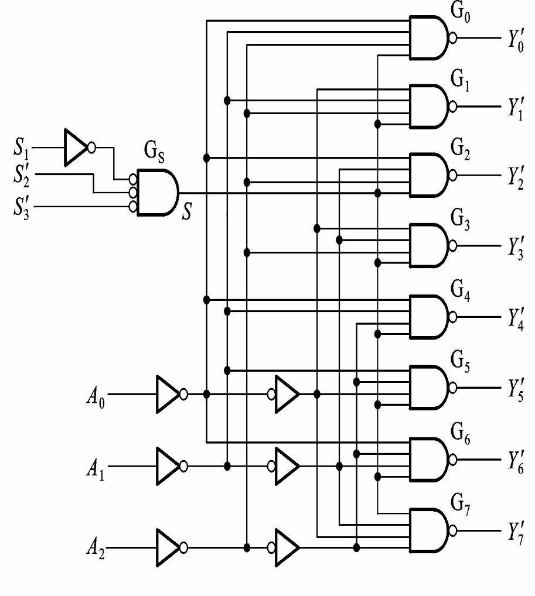
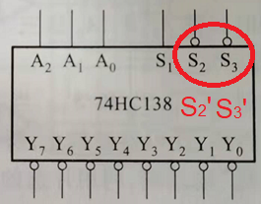
集成译码器实例：74HC138
低电平输出
附加
控制端
S₁: active high
S₂’ and S₃’: active low
Gate G_{S}: S=S₁S₂S₃
Outputs:
Y’_{i}=(Sm_{i})’
S=1: Y’_{i}=m_{i}’
S=0: Y’_{i}=1

Slide 17
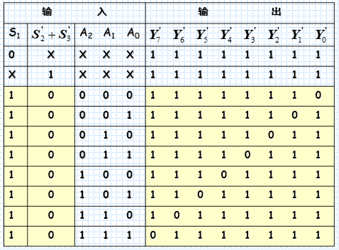
74HC138的功能表：S₁=1, S₂’+S₃’=0 (S₂=1, S₃=1): S=1, 正常工作; 其他情况：输出全为1

